Slide 1

6th Grade Accelerated Math
Unit 11, Lesson 2 Subtracting Rational Numbers Volume 2, pg. 171

Slide 2


Benchmark
MA.7.NSO.2.2
Add, subtract, multiply, and divide rational numbers with procedural fluency.
volume 2, pg. 171

Slide 3
Integrated Mathematical Thinking and Reasoning Standards
MA.K12.MTR.1.1 Actively participate in effortful learning both individually and collectively.
MA.K12.MTR.2.1 Demonstrate understanding by representing problems in multiple ways.
MA.K12.MTR.3.1 Complete tasks with mathematical fluency.
MA.K12.MTR.4.1 Engage in discussions that reflect on the mathematical thinking of self and others.
MA.K12.MTR.5.1 Use patterns and structure to help understand and connect mathematical concepts.
volume 2, pg. 171

Slide 4

Learning Target
I can fluently subtract rational numbers.
volume 2, pg. 171

Slide 5

Warm-Up
volume 2, pg. 171

Slide 6
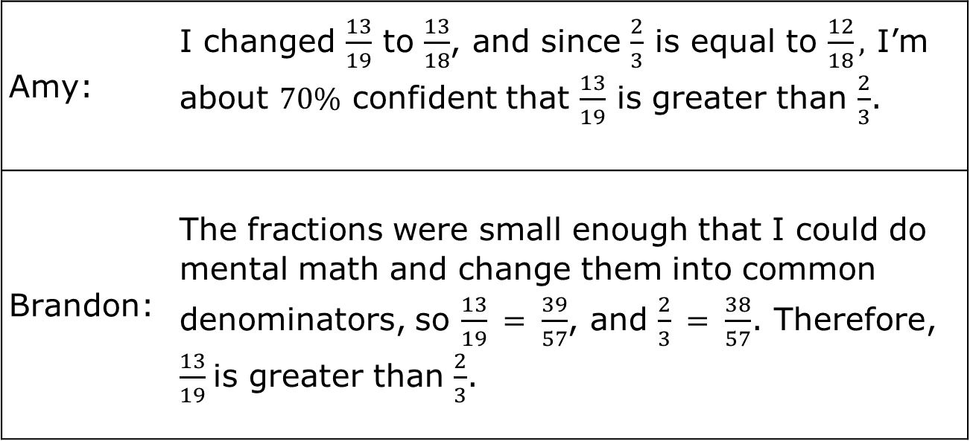

11.2.1 Warm-Up: Math Talk
Several students discussed which fraction was greater, $\frac{13}{19}$ or $\frac{2}{3}$. A summary of the discussion is shown.
Amy: | I changed $\frac{13}{19}$ to $\frac{13}{18}$, and since $\frac{2}{3}$ is equal to $\frac{12}{18},$ I’m about $70\%$ confident that $\frac{13}{19}$ is greater than $\frac{2}{3}$.
Brandon: | The fractions were small enough that I could do mental math and change them into common denominators, so $\frac{13}{19} = \frac{39}{57}$, and $\frac{2}{3} = \frac{38}{57}$. Therefore, $\frac{13}{19}$is greater than $\frac{2}{3}$.
volume 2, pg. 171

Slide 7
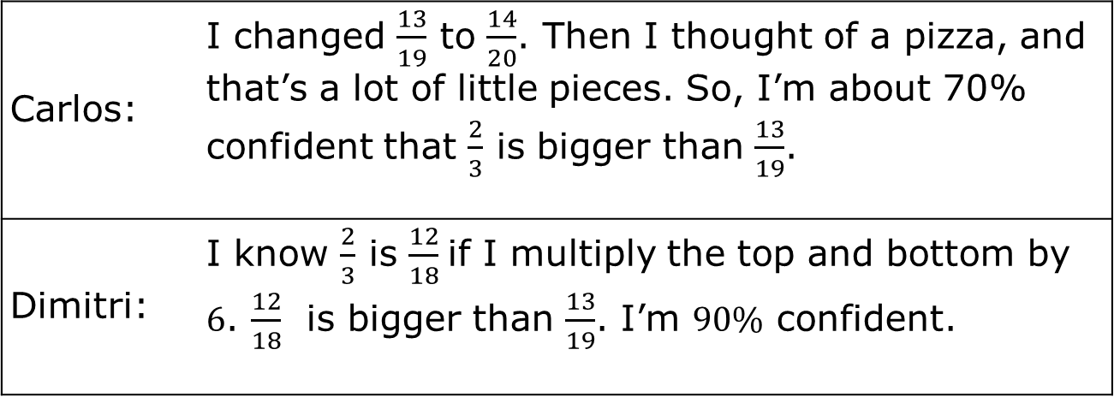
Carlos: | I changed $\frac{13}{19}$ to $\frac{14}{20}$. Then I thought of a pizza, and that’s a lot of little pieces. So, I’m about 70% confident that $\frac{2}{3}$ is bigger than $\frac{13}{19}$.
Dimitri: | I know $\frac{2}{3}$ is $\frac{12}{18}$if I multiply the top and bottom by $6$. $\frac{12}{18}$ is bigger than $\frac{13}{19}$. I’m $90\%$ confident.
Explain which student’s reasoning you agree with.
Choose one student you didn’t agree with, and explain why you did not agree.
volume 2, pg. 171

Slide 8

Guided Instruction
volume 2, pg. 172

Slide 9

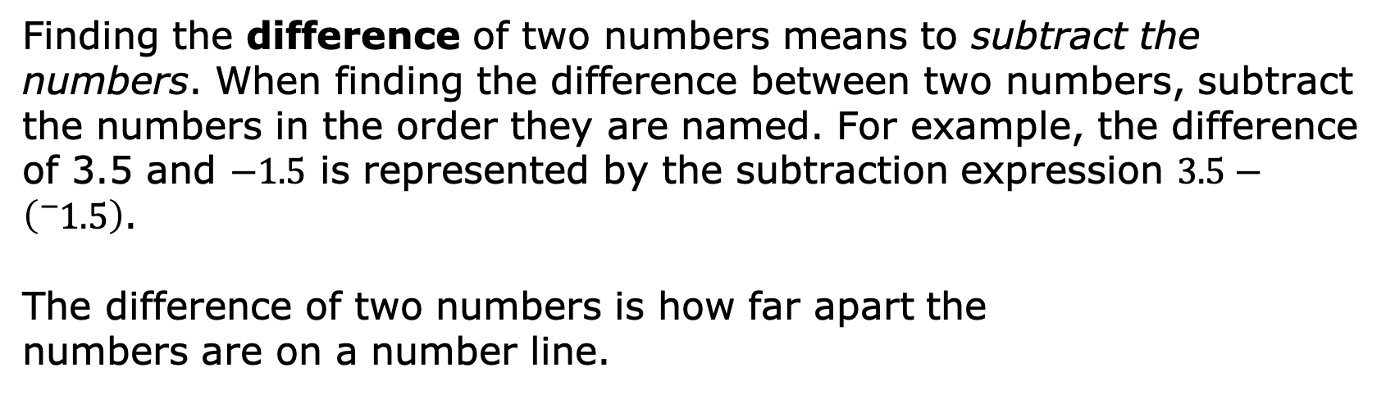
11.2.2 Guided Instruction: Understanding Differences
Finding the difference of two numbers means to subtract the numbers. When finding the difference between two numbers, subtract the numbers in the order they are named. For example, the difference of 3.5 and $−1.5$ is represented by the subtraction expression $3.5−\left({}_{ }^{−}{1.5}\right)$.
The difference of two numbers is how far apart the
numbers are on a number line.
$$+5$$
volume 2, pg. 172

Slide 10
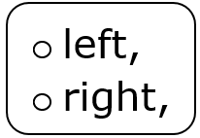
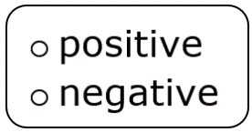

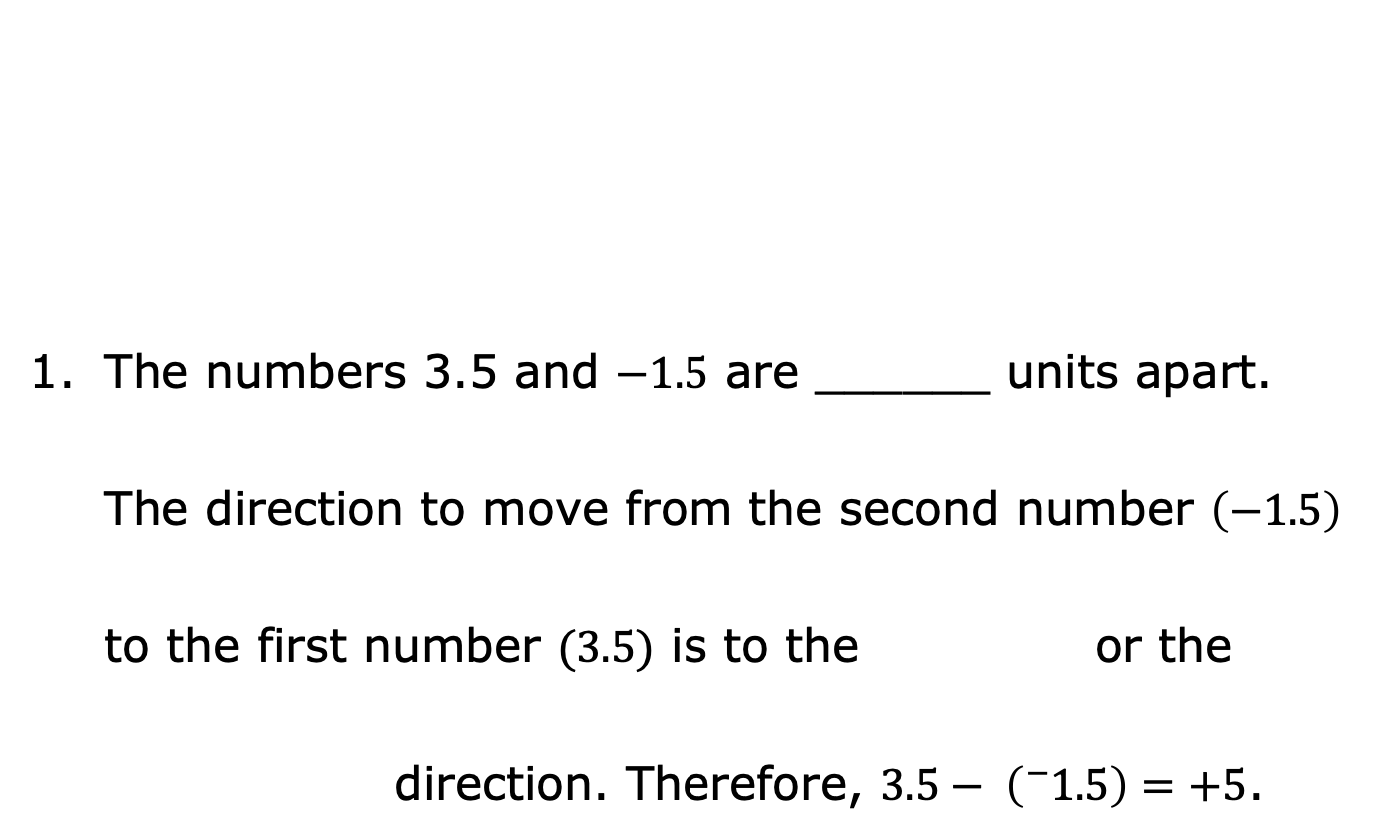
The numbers 3.5 and $−1.5$ are ______ units apart. The direction to move from the second number $\left(−1.5\right)$ to the first number $(3.5)$ is to the or the direction. Therefore, $3.5− \left({}_{ }^{−}{1.5}\right)=+5$.
$$+5$$
volume 2, pg. 172

Slide 11
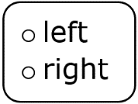
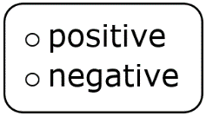

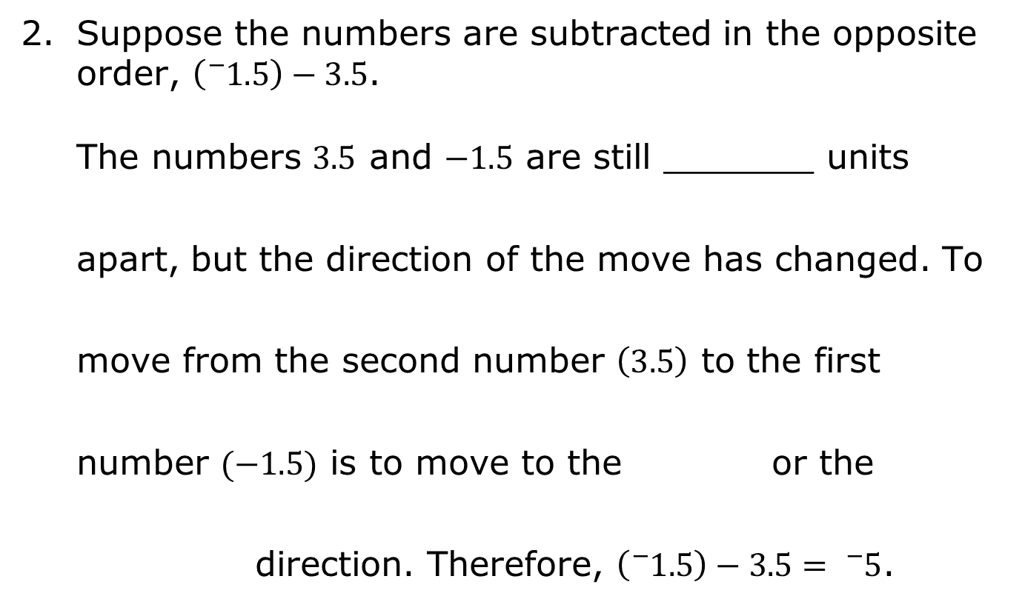
Suppose the numbers are subtracted in the opposite order, $\left({}_{ }^{−}{1.5}\right)−3.5$.
The numbers 3.5 and $−1.5$ are still _______ units apart, but the direction of the move has changed. To move from the second number $\left(3.5\right)$ to the first number $(−1.5)$ is to move to the or the direction. Therefore, $\left({}_{ }^{−}{1.5}\right)−3.5= {}_{ }^{−}5$.
$$−5$$
volume 2, pg. 172

Slide 12

Collaboration
volume 2, pg. 173

Slide 13



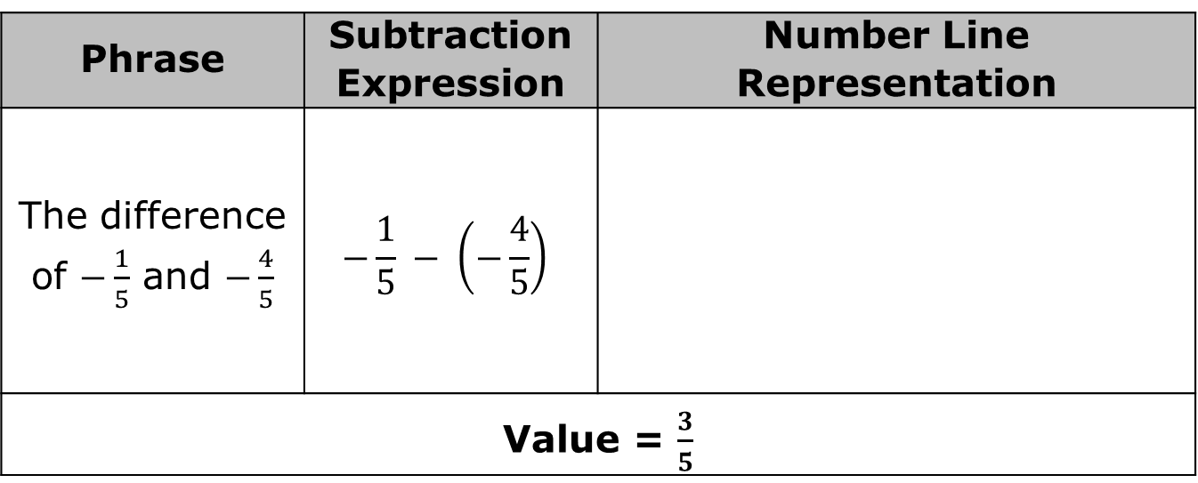
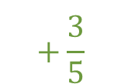
11.2.3 Collaboration: Understanding Differences
Working with your partner, write each phrase as a subtraction expression. Then, draw a number line representation to find the value of the expression. The first phrase has been done for you.
Phrase | Subtraction Expression | Number Line Representation
The difference of $−\frac{1}{5}$ and $−\frac{4}{5}$ | $$−\frac{1}{5} − \left(−\frac{4}{5}\right)$$
Value = $\frac{3}{5}$
$$+\frac{3}{5}$$
$$−\frac{4}{5}$$
$$−\frac{1}{5}$$
volume 2, pg. 173

Slide 14
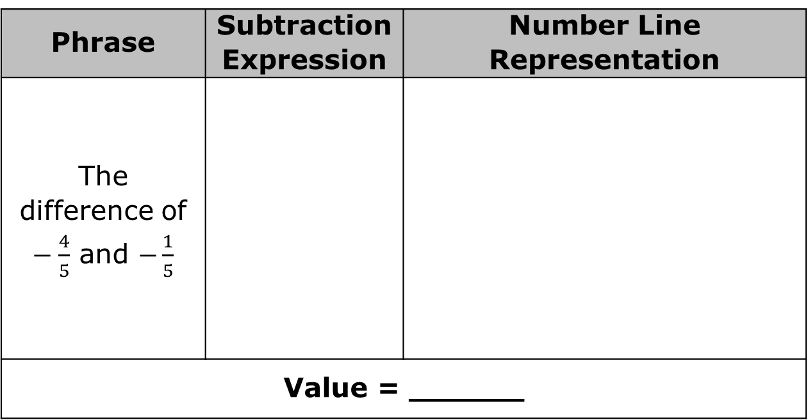
Phrase | Subtraction Expression | Number Line Representation
The difference of $−\frac{4}{5}$ and $−\frac{1}{5}$
Value = ______
volume 2, pg. 173

Slide 15
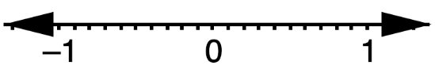
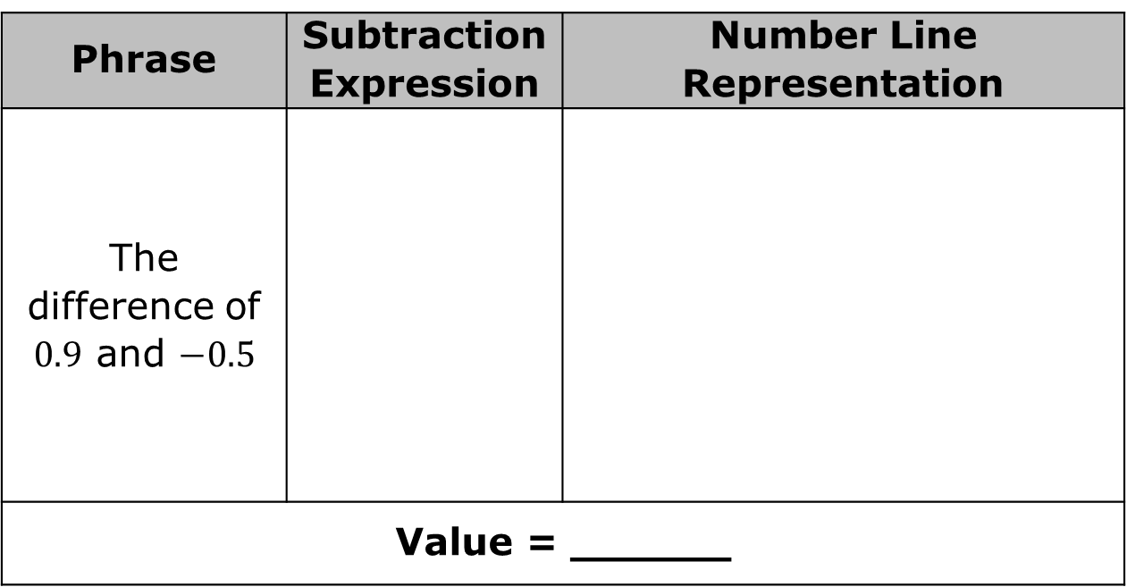
Phrase | Subtraction Expression | Number Line Representation
The difference of $0.9$ and $−0.5$
Value = ______
volume 2, pg. 173

Slide 16
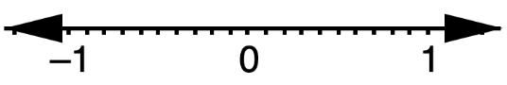
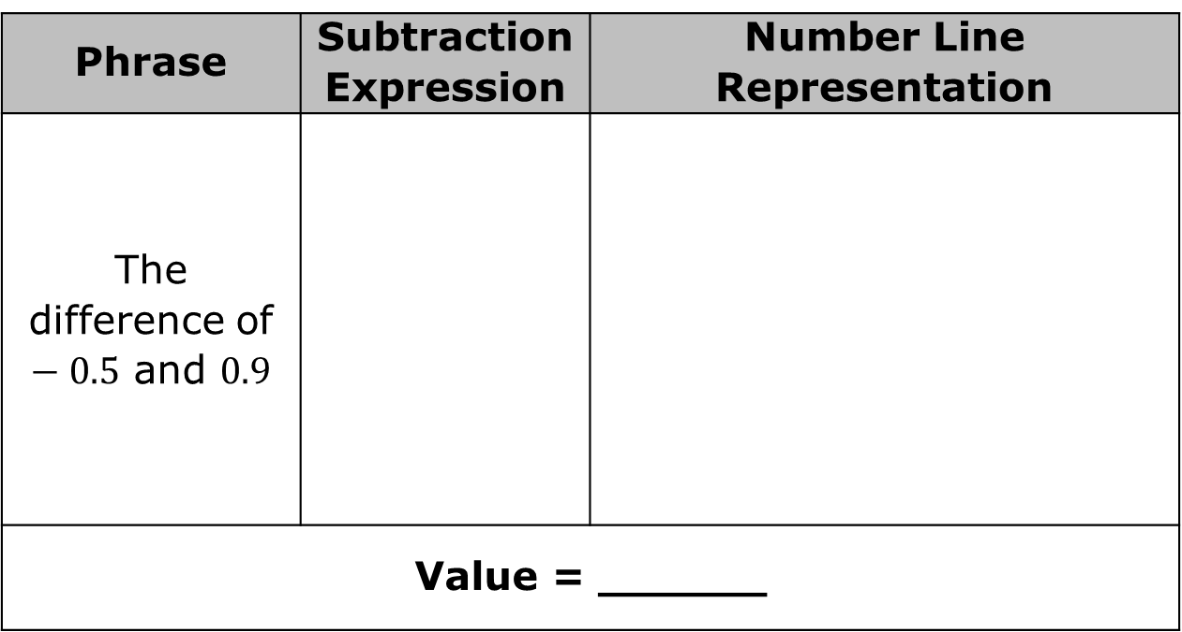
Phrase | Subtraction Expression | Number Line Representation
The difference of $−0.5$ and $0.9$
Value = ______
volume 2, pg. 173

Slide 17
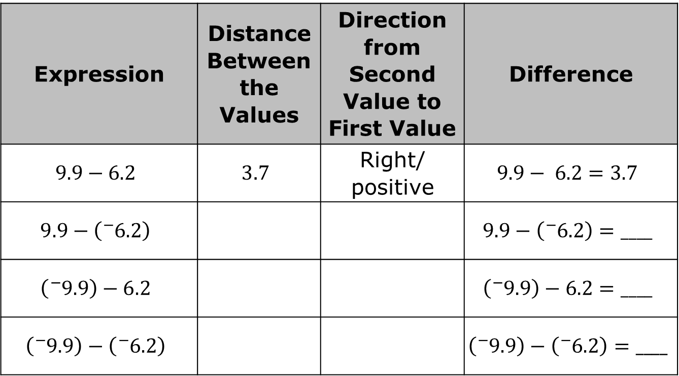
With your partner, complete the table to find the difference of the values.
Expression | Distance Between the Values | Direction from Second Value to First Value | Difference
$$9.9−6.2$$ | $$3.7$$ | Right/ positive | $$9.9− 6.2=3.7$$
$$9.9−\left({}_{ }^{−}{6.2}\right)$$ |  |  | $$9.9−\left({}_{ }^{−}{6.2}\right)=____$$
$$\left({}_{ }^{−}{9.9}\right)−6.2$$ |  |  | $$\left({}_{ }^{−}{9.9}\right)−6.2=____$$
$$\left({}_{ }^{−}{9.9}\right)−\left({}_{ }^{−}{6.2}\right)$$ |  |  | $$\left({}_{ }^{−}{9.9}\right)−\left({}_{ }^{−}{6.2}\right)=____$$
volume 2, pg. 174

Slide 18
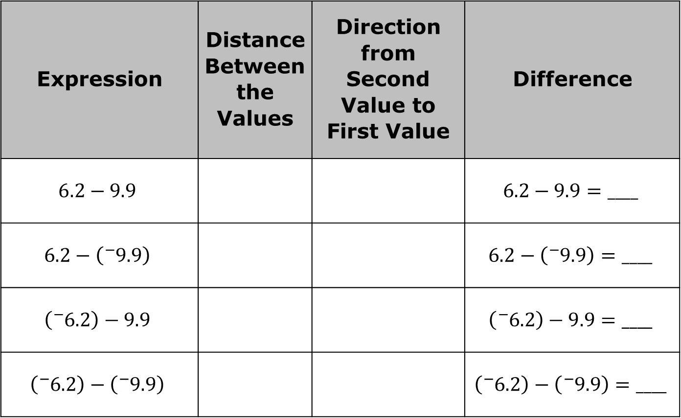
Expression | Distance Between the Values | Direction from Second Value to First Value | Difference
$$6.2−9.9$$ |  |  | $$6.2−9.9=____$$
$$6.2−\left({}_{ }^{−}{9.9}\right)$$ |  |  | $$6.2−\left({}_{ }^{−}{9.9}\right)=____$$
$$\left({}_{ }^{−}{6.2}\right)−9.9$$ |  |  | $$\left({}_{ }^{−}{6.2}\right)−9.9=____$$
$$\left({}_{ }^{−}{6.2}\right)−\left({}_{ }^{−}{9.9}\right)$$ |  |  | $$\left({}_{ }^{−}{6.2}\right)−\left({}_{ }^{−}{9.9}\right)=____$$
volume 2, pg. 174

Slide 19
Guided Instruction
volume 2, pg. 174

Slide 20
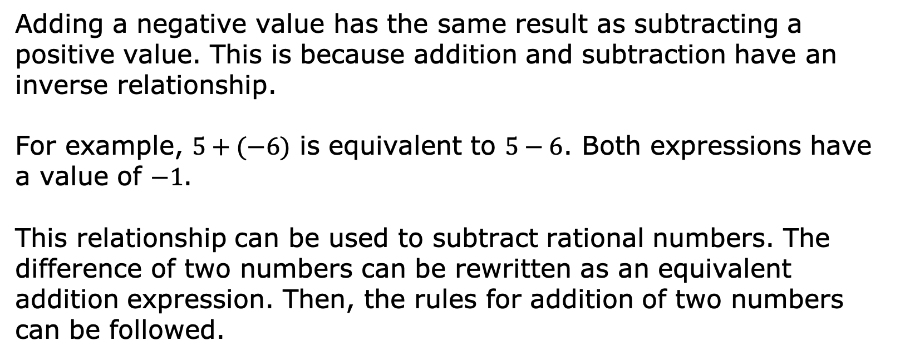
11.2.4 Guided Instruction: Finding Differences
Adding a negative value has the same result as subtracting a positive value. This is because addition and subtraction have an inverse relationship.
For example, $5+(−6)$ is equivalent to $5−6$. Both expressions have a value of $−1$.
This relationship can be used to subtract rational numbers. The difference of two numbers can be rewritten as an equivalent addition expression. Then, the rules for addition of two numbers can be followed.
volume 2, pg. 174

Slide 21
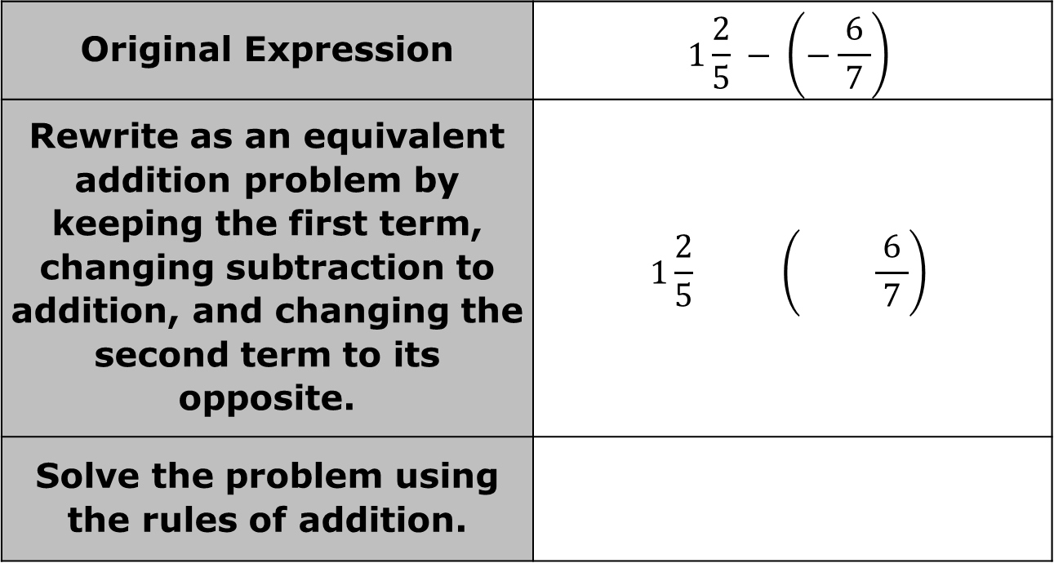
Fill in the blanks to complete the table.
Original Expression | $$1\frac{2}{5} − \left(−\frac{ 6 }{7}\right)$$
Rewrite as an equivalent addition problem by keeping the first term, changing subtraction to addition, and changing the second term to its opposite. | $$1\frac{2}{5} \left( \frac{ 6 }{7}\right)$$
Solve the problem using the rules of addition.
volume 2, pg. 174

Slide 22
Collaboration
volume 2, pg. 175

Slide 23
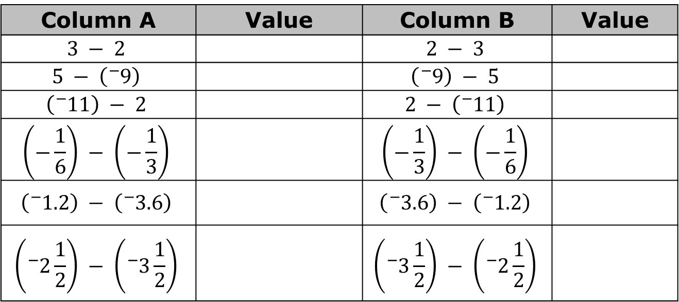
11.2.5 Collaboration: Does the Order Matter?
With your partner, determine who will be Partner A and who will be Partner B. Partner A will work the problems in Column A while Partner B works the problems in Column B. Then, work together to answer the questions that follow.
Column A | Value | Column B | Value
$$3 − 2$$ |  | $$2 − 3$$
$$5 − \left({}_{ }^{−}9\right)$$ |  | $$\left({}_{ }^{−}9\right) − 5$$
$$\left({}_{ }^{−}{11}\right) − 2$$ |  | $$2 − \left({}_{ }^{−}{11}\right)$$
$$\left(−\frac{1}{6}\right) − \left(−\frac{1}{3}\right)$$ |  | $$\left(−\frac{1}{3}\right) − \left(−\frac{1}{6}\right)$$
$$\left({}_{ }^{−}{1.2}\right) − \left({}_{ }^{−}{3.6}\right)$$ |  | $$\left({}_{ }^{−}{3.6}\right) − \left({}_{ }^{−}{1.2}\right)$$
$$\left({}_{ }^{−}2\frac{1}{2}\right) − \left({}_{ }^{−}{3\frac{1}{2}}\right)$$ |  | $$\left({}_{ }^{−}3\frac{1}{2}\right) − \left({}_{ }^{−}{2\frac{1}{2}}\right)$$
volume 2, pg. 175

Slide 24
Explain the difference between the expressions in Column A and the expressions in Column B.
Explain the relationship between the values of the expressions in Column A and the value of the expressions in Column B.
volume 2, pg. 175

Slide 25

Your Turn
volume 2, pg. 175

Slide 26
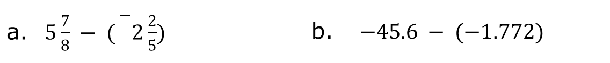
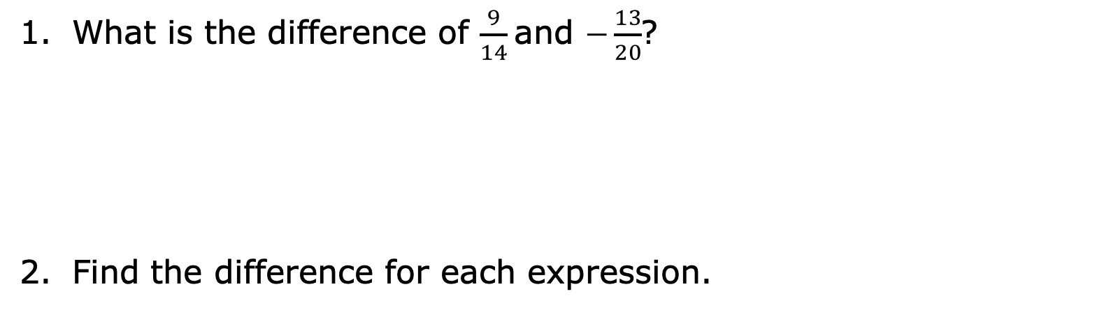
11.2.6 Your Turn!
What is the difference of $\frac{9}{14}$and $−\frac{13}{20}$?
Find the difference for each expression.
$5\frac{7}{8} − ({}_{}^{−}{2\frac{2}{5}) }$ | $−45.6 − (−1.772)$
volume 2, pg. 175

Slide 27

Wrap-Up
volume 2, pg. 176

Slide 28
11.2.7 Wrap-Up: Growth Mindset
Making mistakes is one of the best ways to learn. Reflecting on our mistakes helps our brains to look for that mistake again and to avoid it the next time.
What mistake did you make today that you can learn from?
Means
I
Start
To
Acquire
Knowledge
Experience
Skills
volume 2, pg. 176

